Slide 1


TITLE
SPRING 2023 CAPSTONE PROJECT
SUBCONSCIOUS
MAKE THE SUBCONSCIOUS CONSCIOUS
SUBCONSCIOUS

Slide 2
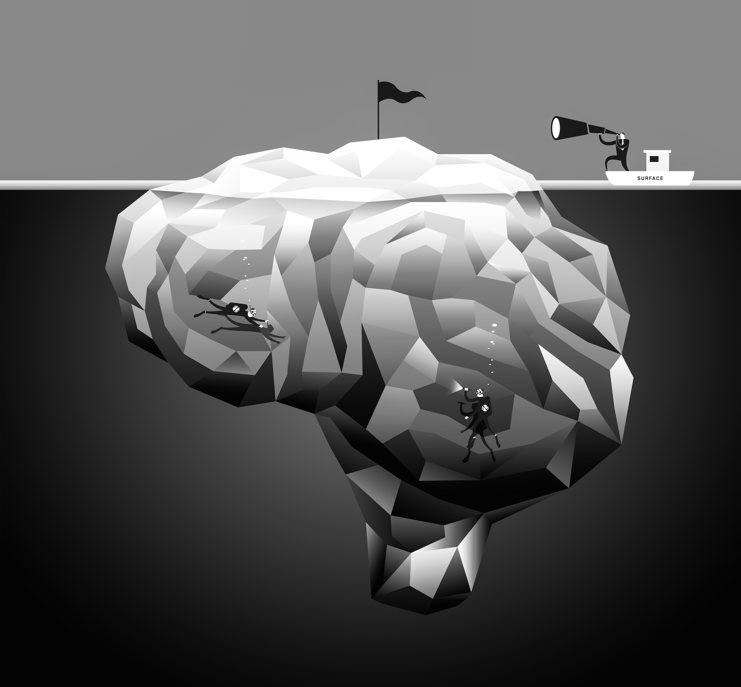
Agenda
The challenge to solve
How we went about solving it: methods and approach
Results summary
Our results: Production features
Our results: Content features
Our results: Market features
Discussion and reflection

Slide 3
Executive summary of results
Market Features​ (Total Features: 08)​ | Content Features​ (Total Features: 22)​ | Production Features​ (Total Features: 09)​
Industry Categorization | Logo taking up most of the screen | Word Confidence
Industry Subcategoryization | Logo small part of screen | ​Sentiment Analysis
Company Name Identification | Spoken branding | Number of Speakers
Logo Selection​ by Frame Count | Number of Frames - logo | Average Scene Duration
Total time logo duration by video | Average area covered by logos | Genre, Era, Instruments, Scale
​Label/Object Detection | Tag Line – visual | BPM, Loudness
Dominant Words Extraction | ​Tag line – spoken | ​Shot Duration
​Logo Detection and Selection | ​Position of the logo | ​Volume Level
​ | ​Visual Branding | ​Audio Pauses
​ | ​Key phrase in the video | ​
​ | ​key message - visual | ​
 | key message- spoken
 | Time stamp of key phrase
Extracted Features: 08 | Extracted Features: 13 | Extracted Features: 09

Slide 4
Results: Production Features

Slide 5
Production Features
Production features in video analytics refer to the tools and capabilities that are specifically designed for video production and post-production purposes.
These features can be found in various software applications, including video analytics software, and can help to streamline the production process and enhance the quality of the final product.
Additionally, production features in video analytics enable video producers to extract valuable insights and information from video data that would be difficult or impossible to obtain through manual analysis.
Overall, production features in video analytics are essential tools for modern video production, enabling video producers to create high-quality content more efficiently and effectively than ever before.

Slide 6
Production Feature Description
Features | Feature Description | Accuracy
Shot Duration | Identifies the boundaries of shots in video sequence | 100% - Accuracy. Validated using manual testing
Audio Pause Detection | Extracted the segments of the audio signal where the energy level falls below a certain threshold for a certain duration of time. | 100% based on manual testing using Audacity
Volume Detection | Measure of the dBFS scale of audio file based on the loudness of an audio signal relative to its maximum possible level, which is usually represented as 0 dBFS | +-0.5 Dbfs ( When compared using Audacity, an easy-to-use, multi-track audio editor and recorder for Windows, macOS, GNU/Linux, and other operating systems)
Speech Analysis | The features that we detected are the average word confidence, sentiment analysis, speaker identification and average scene duration respectively. Output was in JSON format. | We have got an average accuracy of greater than 75% for all the features detected in all the batch of videos. It was ranging from greater than 75% to 93%.
Music Detection | Have analyzed the duration of the video, bitrate, size, codec, channels, frame rate and height of the video. We have found the instruments, genre, era, BPM and loudness. Output was in JSON format. | Got an average accuracy ranging 75% to 90% for all the features in all batches of videos after multiple iterations. Used the first batch for training, second batch of videos for testing, and third batch for validation.

Slide 7




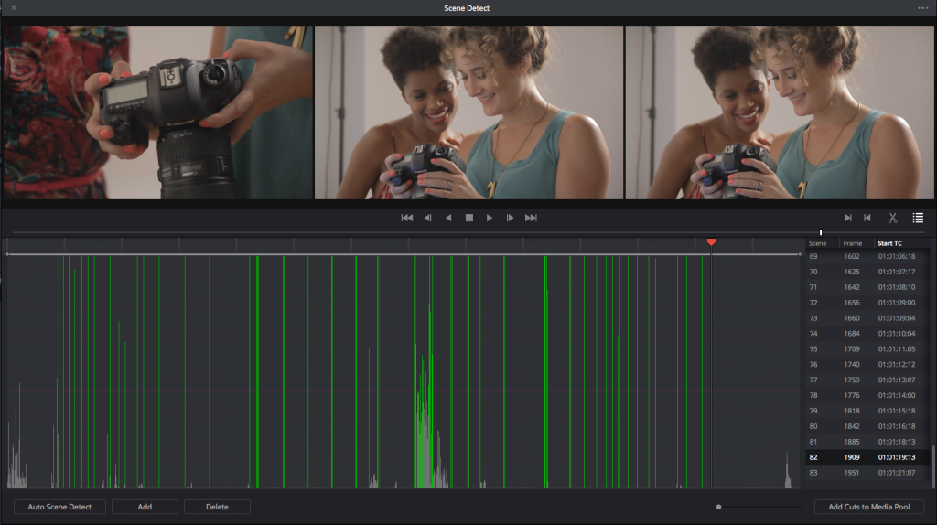
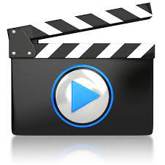

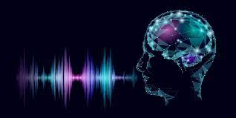


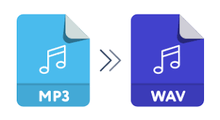
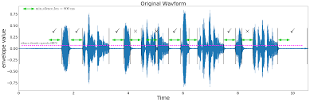
Methodology
Output
Store all 133 videos in cloud storage
google cloud function
video Intelligence API
cloud storage (video (annotation JSON)
Cut scene detection
Video Content
Speech transcription
Integrate with frontend engine (python)
Assembly API for
Confidence assessment
get all .wav files in a folder
open segment length txt file
Create speechFile in speechFile list
Load audio by speechFile
Extract fileID
Split audio to segment and extract time
length
Video conversion
Close summary txt file
Volume Detection | Audio Pause Detection

Slide 8
Methodology
Shot Change Detection and Audio Volume Detection:
The shot change detection Google API is a video analysis tool that uses machine learning algorithms to automatically detect and segment different shots within a video. Steps performed by the algorithm are as follows:
Video ingestion: The video file is uploaded to the Google Cloud Storage bucket
Video processing: The video is then passed through a set of machine learning algorithms that analyze the video frames and detect shot changes based on the frame changes.
Shot segmentation: Once a shot change is detected, the video is segmented into different shots.
Shot information extraction: For each shot, the API extracts various metadata, such as the start and end time of the shot and the duration of the shot.
File Conversion: The MP4 file is converted to WAV format for audio processing.
Volume Detection: Once the shots are identified, the Python code detects the average and maximum volume of each individual shot by considering the Root Mean Square amplitude of the waveform. The RMS amplitude represents the average power of an audio signal over a given time period and is often used to measure the loudness or volume of an audio file.

Slide 9
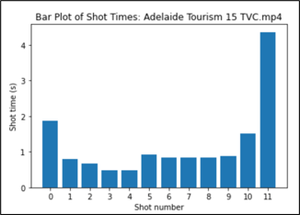
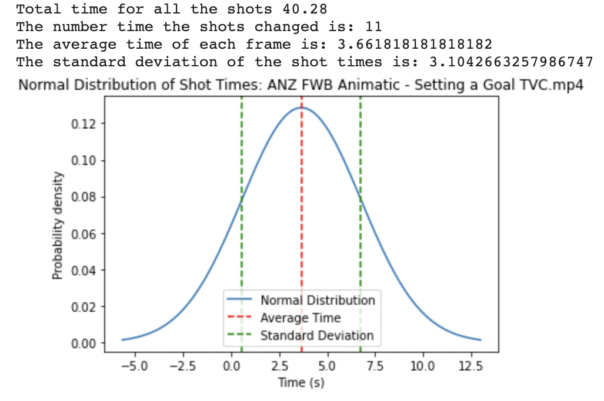
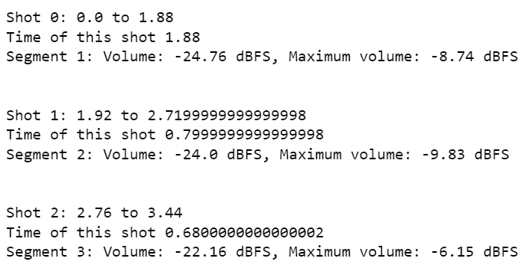
Our Result: Production features
Shot Change Detection | Audio Volume Detection
The algorithm detected each video’s frame changes and volume level.
The bar plot and Gaussian distribution graph represent each individual shot with respect to time and the average shot timing respectively.
For Shot change detection a total of over 133 videos were tested manually resulting in 100% accuracy.
The algorithm even detected videos with no frame changes.
After detecting the frame length for each shot of a video, the average volume and maximum volume for that frame length were calculated by using the Root Mean Square of the audio waveform.
Algorithm also captured videos with no sound.

Slide 10
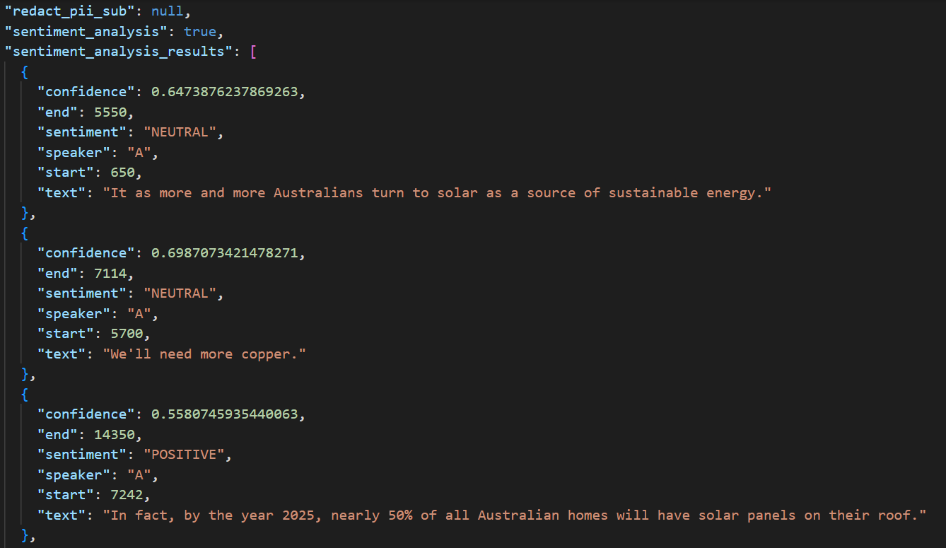
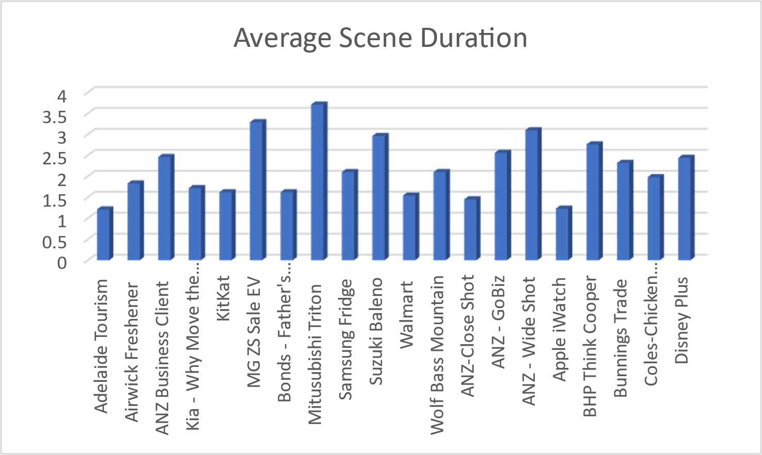
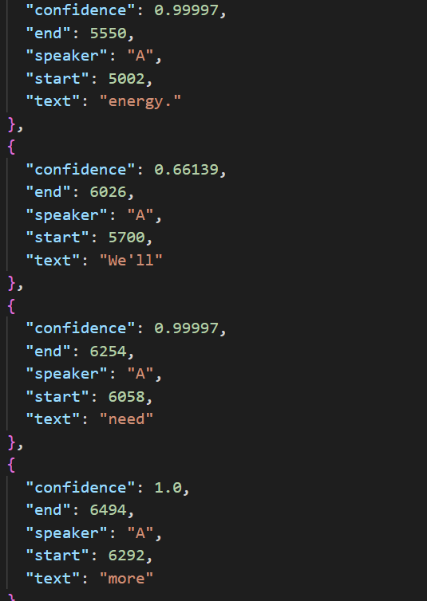
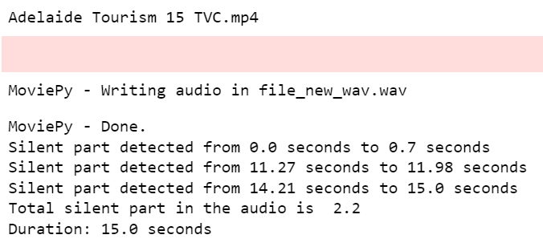
Our Result: Production features
Sample Results:-
Audio Pause Detection
This is the technique to determine the pause length a narrator takes while speaking in audio.
Importance of Audio Pause Detection in terms of Speech Recognition, Audio Editing, Transcription, and Music Analysis
Thresholds: min_silence_len = 400 # in milliseconds silence_thresh = -30 # in dBFS
Sample Results
Sentiment Analysis
Average Scene Duration – 20 videos
Speech Analysis | Word Confidence Detection:-
Used cloud video intelligence and Assembly Api Analyzed all the 3 batch of videos for training, testing and validation, respectively.
Sample results
Maximum Confidence score is 99% and on average 90%.
Number of Speakers detected = 2
Average length of scene is 2.46 seconds.
In sentiment analysis have identified all positive, and neutral statements.
Word Confidence Level

Slide 11
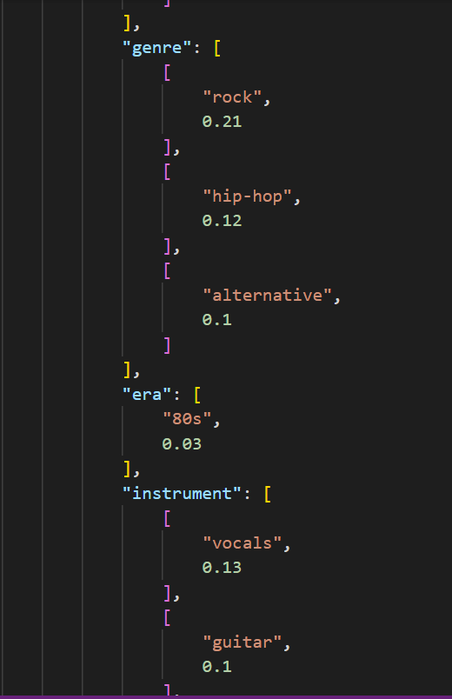
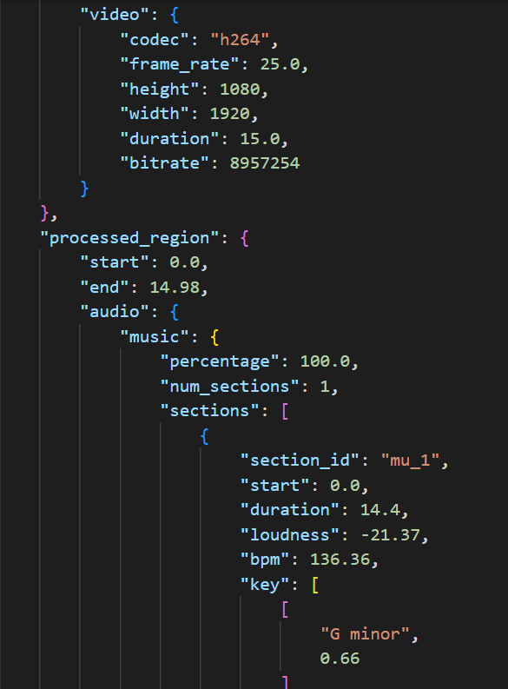
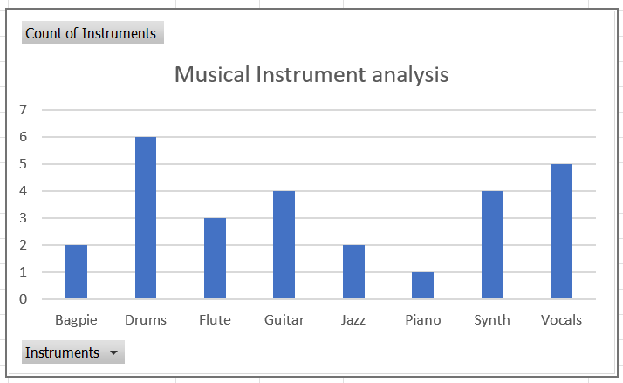
Our Result: Production features
Musical Features Extraction:-
The algorithm extracts musical features. Output is depicted in a JSON format.
Analyzed over 100 videos and performed the validation and testing using batches of videos, in iterations of 10, 20, 50 to improve the accuracy.
We used first batch of videos for training, second batch for testing, and third batch for validation.
However, it resulted in same accuracy and were not able to further improve it. Got an accuracy ranging 75% to 90%. The algorithm analyzed the sound as part of video.
Sample results
Height and Width of video = 1080 * 1920
Duration = 14.4 seconds
Codec = AAC, bitrate
Scale = G Minor
Loudness = 21.37 dB
BPM = 136.36
Era = 80s
Genre = Rock, Hip Hop, Alternative
Instruments = Guitar, Drum, Synth, Vocals
Sample Results: Musical Features and Video analysis
Count of instruments detected for a batch of 5 videos

Slide 12
Production features attempted, but need more work
Gender Detection
The feature was attempted but the desired result was not achieved.
Limitation:
Multiple audio files test indicated that the code could capture the first speaker in the video but when there are multiple speakers, it only detects the first speaker.
Inability to synchronize the Rapid API with Python
Automated Tabulated outputs for feature extraction
Limitation:
•Began using Spreadsheet API, and had the output was neat and precise.
•However, it was time-consuming and required multiple runs of iterations, and also faced immense crashes in the process.
•Hence, we switched to using CSV output.

Slide 13
Results: Content Features

Slide 14
Our Challenges: Content Detection
Branding moments for each ad ​
Logo in any format – visual moment ​
Spoken Moment – music, song, style​
Time Stamp of that moment ​
​
Key message of the Ads ​
Time stamp of the key message ​
Was the Key message delivered?​
What was the key message?

Slide 15
Results summary
Content Features | Feature Description | Accuracy
Branding in the body of the ad | We defined branding moment as when brand logo is present on the screen | 90%
Key Message Detection | Specific features, benefits, and attributes of a product that the advertiser is promoting. These claims and details are often presented in the form of text/images/spoken/visual within the ad and are designed to persuade the audience to buy the product. | 85%

Slide 16
Our results: Content Features
Content Features | Sub - Categories
Branding in the body of the ad | Logo taking up most of the screen
 | Logo small part of screen
 | Spoken branding
 | Number of Frames - logo
 | Average area covered by logos
 | Tag Line – visual
 | Tag line – spoken
 | Position of the logo
 | Visual Branding
Key message detection | Key phrase in the video
 | key phrase - visual
 | key phrase - spoken
 | Time stamp of key phrase
Total Features | 13 out of 22

Slide 17
Methodology
Detection of Branding Moment
Approach 1: Generate new metrics.
Approach 2: Using ML classifier models.
Detection of Key Messages
Approach 1: Using pre trained language models.
Approach 2: Using function with regular expression.

Slide 18
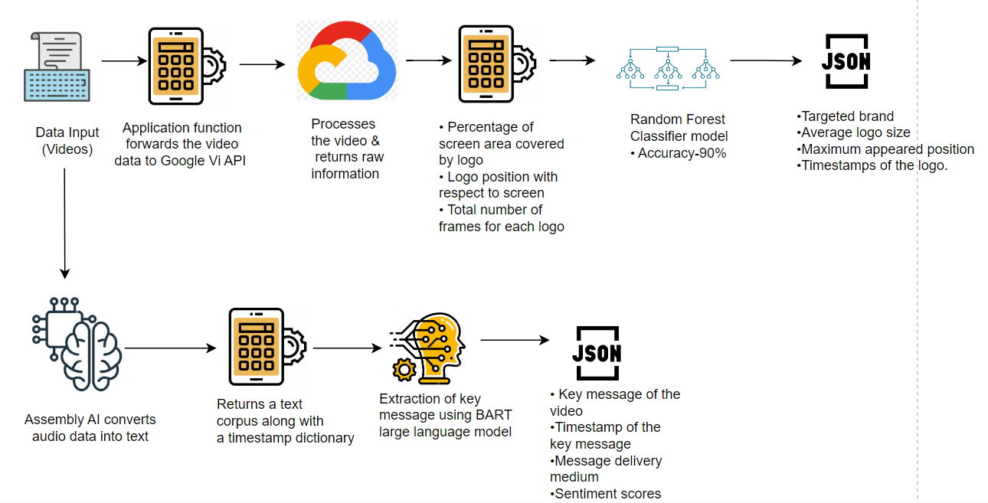
Methodology
Notes:
Approach 2:
Google Speech recognition API, NLP techniques, Open CV, and personal Developed Code.
Inputs: mp4 file
Output: txt and jpg (frames)

Slide 19
Our results: Content features attempted, but need more work
Collect words or phrases that can be used for sub-categorization of key phrases.
Extraction of more detailed features like logo superimposed, and branded product shot by exploring other APIs/Open Source.
Vertex AI

Slide 20
Our results: Content features to consider for the future
Identifying unique selling proposition
Attention-grabbing moments
Story of the AD

Slide 21
Results: Market Features

Slide 22
Our Challenge: Industry Classification
Challenge:
Classify advertisement videos into the correct Industry Category and Subcategory
Example:
Given a Nike video, classify it into Industry Category: Apparel and Footwear and subcategory: Athletic & Sporting Goods
To achieve this target, we followed two distinct approaches:
Logo Detection with Dominant Words
Logo detection with Openai Classification

Slide 23
Industry Classification
Methodology - Approach Logo Detection with Dominant Words
Using Yake and Summa, detected dominant words from speech transcription. Using APIs, detected Logos to classify videos into respective industries.
Challenges - Approach Logo Detection with Dominant Words
Some wrong/or no detection of logos
API functionality Issues
Model Building
Notes:
Notes from earlier PPT:
(Approach 1 – summary
Object/Label Detection, Logo Detection, Speech Transcription, Dominant Words extraction.
Extract Dominant Words from speech transcription to predict the industry of videos.
Used results from the logo detection to predict the industry.
Combined both LOGO and DOMINANT words results as our features to detect Industries.
Approach 2 – summary
Similarly, for logo detection and categorization, we used the following approaches:
Extract logos from video using Google Cloud Video Intelligence API
Used confidence level, and logo frame count model to match the correct company
Implemented Davinci003 database from OpenAI, which provided us with the company name, Industry Category and Subcategory)
…...........................................................................................................................
Some wrong/or no detection of logos
API Issues
Model Building
Work on dataset with 7 million rows.

Slide 24
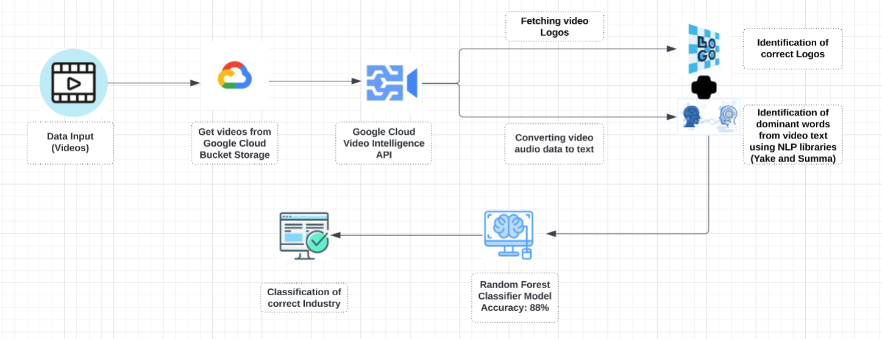
Code Flow - Logo Detection with Dominant Words

Slide 25
Our results: Successfully Categorize Video Advertisement into the Correct Industry
Features | Description | Accuracy/Performance
Logo detection (detect_logos) | Use Google Cloud Video Intelligence API to detect logos and get their corresponding data. | For logo detection using Random Forest Algorithm to predict correct logo. 80% train and 20% test. For NLP: Accuracy of 85%, 5% of videos logo were not detected
Logo Selection (logo_selection) | Identify the predominant logo from an advertisement video. Selection rules are confidence interval of >= 0.93 and highest number of frames appearances and store results in a .json file. | Output has an accuracy of around 95%
Speech Transcription and Dominant Words extraction | Use Video Intellegence API to get speech from videos. Additionally Using Yake and SUMMA (NLP) to detect the most dominant words from the speech. | As output, these in-built libraries gives the dominant words based on the entire speech in the vide considering weightage of the words (Weightage of wors should be more than 0.17 since the text size is small).
Industry Categorization | Used Logo name and Dominant words results as our independent variables to classify under market category. | Split 233 videos in 70-30 ratio and appended into the existing training dataset that was sourced from Kaggle. Built several AI models and received best accuracy of 88%.. we can confirm that out of 100, 88% of the times video will be classified to a correct category.
Industry categorization (openai_categorizer) | Use company name from detect_logos function and classify it under a market category and sub-category using davinci-003 from Openai | Using OpenAi models we can achieve high accuracy and recall rates of up to 90% or higher.
Notes:
Created a model that sorts videos into arrays and two separate outputs of both recognized and unrecognized logos
Implemented a function (DaVinci003) which was trained on a huge dataset, is futureproof and can work for other applications too
Successfully able to obtain the correct Industry Category and Subcategory for an average of 80% of videos with an accuracy of .95

Slide 26
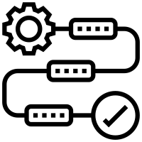
Industry Classification
Methodology - Approach Logo Detection with Openai Classification
The main aim for this project was to categories an advertisement to the right industry. To achieve this target, we followed two different approaches
Used Google Cloud Video Intelligence and DaVinci003 APIs to detect logos on trained model and create an output database
Some wrong/or no detection of logos
Reliant on third party API services
Limited number of videos provided to train model
Time constraint for refining model further
Challenges
Notes:
Notes from earlier PPT:
(Approach 1 – summary
Object/Label Detection, Logo Detection, Speech Transcription, Dominant Words extraction.
Extract Dominant Words from speech transcription to predict the industry of videos.
Used results from the logo detection to predict the industry.
Combined both LOGO and DOMINANT words results as our features to detect Industries.
Approach 2 – summary
Similarly, for logo detection and categorization, we used the following approaches:
Extract logos from video using Google Cloud Video Intelligence API
Used confidence level, and logo frame count model to match the correct company
Implemented Davinci003 database from OpenAI, which provided us with the company name, Industry Category and Subcategory)
…...........................................................................................................................
Some wrong/or no detection of logos
API Issues
Model Building
Work on dataset with 7 million rows.

Slide 27
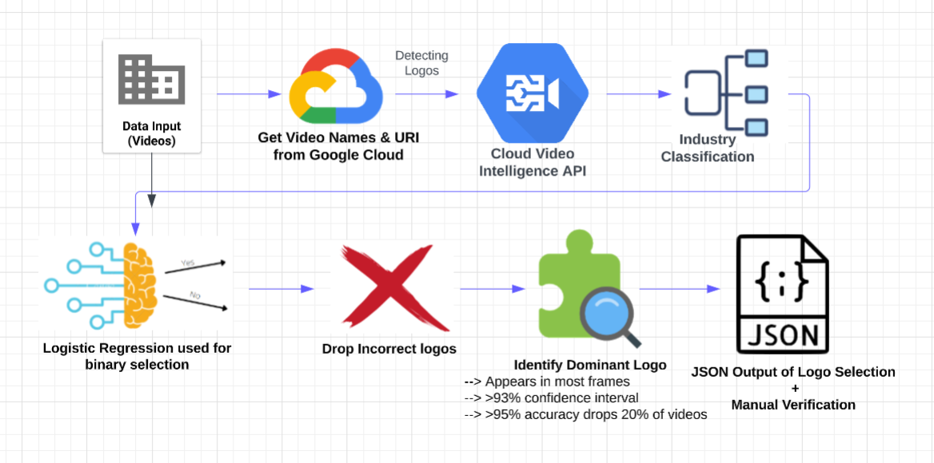
Code Flow - Logo detection with Openai Classification
Notes:
Code Flow:
Data input (videos)
->get video names and uri from Google Cloud
->cloud video intellingence logo detection
->Company names passed to openai davinci-003 for industry category and subcategory
->pass logo frames, confidence, total frames as percentage to logicistic regression to get binary selection is logo correct or incorrect
->drop logos that are incorrect
->to select 1 predominant logo select anything above .93 confidence and select logo with largest number of fames total
->95% accuracy but drop 20% of the videos
JSON Output of Logo Selection
> JSON Output of Logos that need manual verification

Slide 28

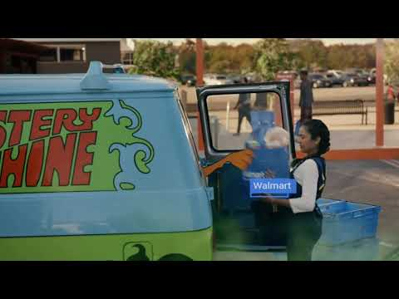
Our results: Market features

Slide 29
Our results: Market features attempted, but need more work
Label/object detection: We got some useful objects, but they were not sufficient to classify the video
Logo Detection: Some videos with logos still not detected/identified
We were at capacity with the number of videos provided, more videos might lead to better results
Logo Detection with Dominant Words

Slide 30

Our results: Market features to consider for the future
Planned on seamlessly combining both NLP and Cloud Video Intelligence algorithms to detect industries missed by the other algorithm
Due to time constraint, we were not able to integrate both working algorithms into one, which can be something to work on in the future
Embed logo size detection into algorithm from Team 7
Fine-tune DaVinci003 hyperparameters as per Neuro Insight needs
Use of Ensemble modeling, GridSearchCV and some other advanced ML techniques to increase accuracy of the NLTP algorithm

Slide 31
Discussion: Future Direction

Slide 32
Future development ideas
Tweak APIs to introduce accent to improve results.
Extraction of more detailed features like logo superimposed, branded product shot by exploring other APIs/Open-source libraries.
Create data repository.
For the Narrator’s gender detection, collaborate with the Rapid API team to figure out a way to implement the API in Python.
Figure out an API to separate music from the Narrator’s audio to perform audio pause detection and gender detection with more accuracy.

Slide 33
Reflection on the journey
How to use API and integrate different APIs'.
Learnt how to work with video data.
Learnt to collaborate with different teams on a larger project.

Slide 34
THANK YOU!
SUBCONSCIOUS
MAKE THE SUBCONSCIOUS CONSCIOUS
SUBCONSCIOUS

